Slide 1
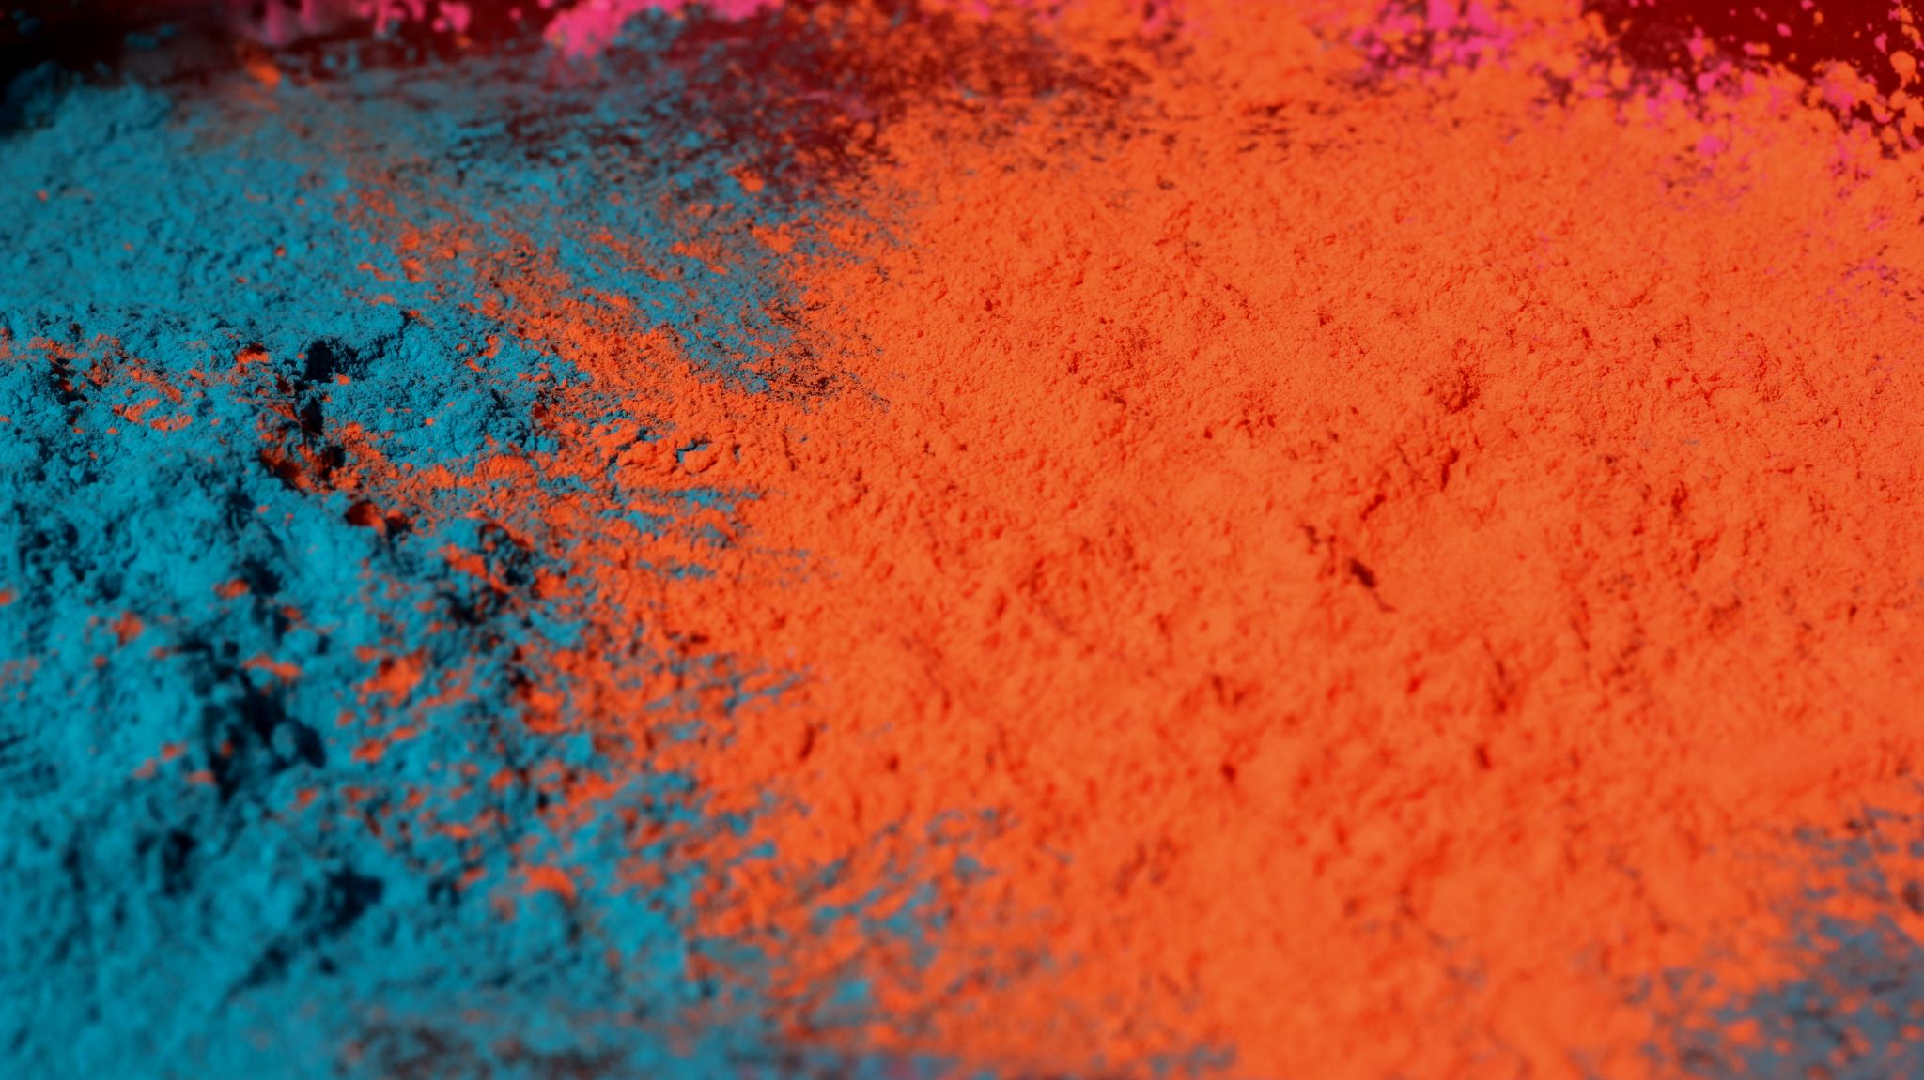
Major Project 1
Cancer-Prediction

Slide 2
Cancer-Prediction
Machine Learning is used to predict and classify Breast Cancer into malignant or benign from 30 attributes such as radius, texture, area, smoothness and concavity etc.

Slide 3
About Model
Breast cancer prediction using dense Feedforward Neural Network in python.
Hidden layer activation function- Relu.
Output layer activation function- Sigmoid.
Loss function- Binary cross entropy.
Optimizer- Adam.

Slide 4
Modules
* Keras
* Dataset is imported from Scikit-learn library

Slide 5
Step 1. Download Data set: - Download the data set from Kaggle or UCI Machine Learning Repository.

Slide 6
Step 2. Preprocess data:
Preprocessing is the most important step in any machine learning project.
The data we have consist of 569 records with 32 columns/features. Most of the data is numeric and one categorical feature which is the target class.
Following are the operations performed in preprocessing.
Data set consist of one extra column “Unnamed: 32” with 569 NaN values which is removed.
ID column is set as index.

Slide 7
Step 3. Feature Engineering: -
Feature engineering is the process of preparing datasets and features in a machine compatible format.
Following are the operations performed in Feature Engineering.
Encoding Categorical Feature- Encoded the class label using LabelEncoder.
Feature Scaling- Scaled numerical features using standard scaler from Sklearn .
Split data- Split data into train and test data set.
Feature Selection- Feature selection is an important step to identify features that are more helpful in predicting the class of diagnosis. For feature selection we have used Embedded technique by using RandomForestClassifier to get important features.
Lastly create data set with top important features. We have more than 30 features of which top 12 features are selected to create a training data set for our model.

Slide 8
Step 4. Model Building: -
For building ANN we have used Google Colab as web IDE for python and machine learning. And multiple libraries to create model such as Keras.
Keras to create Sequential model. And Dense to add hidden layer.
The model consists of input layer, one hidden layer and an output layer. These layers consist of parameters such as for classification problem we have used
Input layer – It consist of 12 input and we have used “relu” as activation function with “he_uniform” as weight initialization. This is because relu works very well with he_uniform.
Hidden layer- It consist of “relu” as activation function with “he_uniform” as weight initialization and different number of neurons in different models.
Output laye- The output layer consists of only a single neuron. With activation function and “sigmoid” and weight initialization as “glorot_uniform”. The combination of sigmoid and glorot_uniform is good for binary classification.

Slide 9
Compile the Model
To compile the model, we have used multiple optimizers such as Adamax, and Adam along with the loss function “binary_crossentropy” for binary class classification and metrics as “accuracy”.

Slide 10

Model Evaluation: -
To evaluate the accuracy of the classification model we have F1 score, Classification Report, Confusion Matrix and others.

